Slide 1
Diagonalization

Slide 2

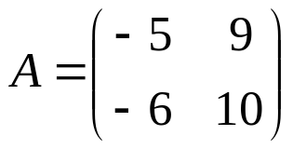
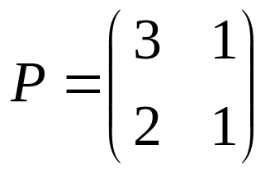
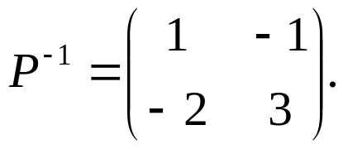
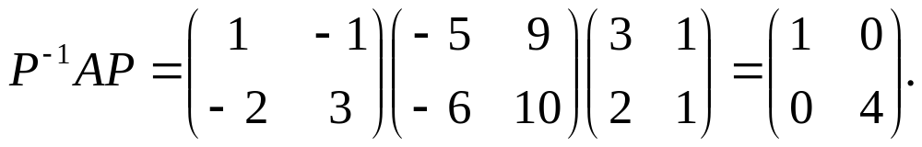
DEFINITION: A square matrix A is said to be diagonalizable if it is similar to some diagonal matrix.
That is, if there exists an invertible matrix P such that is diagonal. In this case the matrix P is said to diagonalize A.
Example1: The matrix is diagonalizable.
Soln: Take then
Therefore,
Hence diagonalize

Slide 3

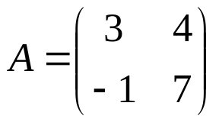
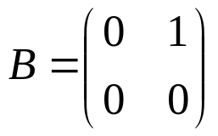
Example2: Any diagonal matrix is diagonalizable.
Soln:
Let D be diagonal matrix. WKT, DA=AD for any matrix A.
For any matrix P,
Example3: Any symmetric matrix is diagonalizable.
Example4: The following matrices are non diagonalizable.
(For justification Example3 and Example4, we use the following results)

Slide 4
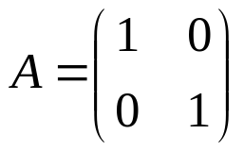
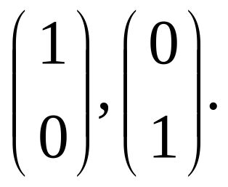
THEOREM If A is an n × n matrix, the following statements are equivalent.
(a) A is diagonalizable.
(b) A has n linearly independent eigenvectors
Example:
The matrix is diagonalizable.
Note that A has repeated eigen values 1, 1 and A has two independent eigenvectors corresponding to the eigenvalue 1,
By above Theorem, A is diagonalizable.

Slide 5

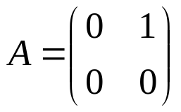

Example: The matrix is not diagonalizable.
Solution: Eigen values of A are 5, 5 (Repeated roots).
Eigen vector corresponding to 5 is
Since the number of independent eigen vector is 1, by above Theorem, the matrix A is not diagonalizable.
Example: The matrix is not diagonalizable.
Solution: Eigen values of A are 0, 0 (Repeated roots).
Eigen vector corresponding to 0 is
Since the number of independent eigen vector is 1, by above Theorem, the matrix A is not diagonalizable.

Slide 6
THEOREM
(a) If λ1, λ2, . . . , λk are distinct eigen values of a matrix A, and if v1, v2, . . . , vk are corresponding eigenvectors, then {v1, v2, . . . , vk} is a linearly independent set.
(b) An n × n matrix with n distinct eigenvalues is diagonalizable.
Example:
The matrix is diagonalizable.
Since A has two distinct eigen values (1 and 4). By above Theorem, A is diagonalizable.

Slide 7

DEFINITION A square matrix A is said to be orthogonally diagonalizable If there exists an orthogonal matrix P such that is diagonal. In this case the matrix P is said to orthogonally diagonalize A.
Note: P is orthogonal if
THEOREM
An n × n matrix A can be orthogonally diagonalized if and only if A is symmetric.

Slide 8
A Procedure for Diagonalizing an n × n Matrix
Step1. Determine first whether the matrix is actually diagonalizable by searching for n linearly independent eigenvectors. One way to do this is to find a basis for each eigenspace and count the total number of vectors obtained. If there is a total of n vectors, then the matrix is diagonalizable, and if the total is less than n, then it is not.
Step 2. If you ascertained that the matrix is diagonalizable, then form the matrix P = [p1 p2…pn] whose column vectors are the n basis vectors obtained in Step 1.
Step 3. will be a diagonal matrix whose successive diagonal entries are the eigenvalues λ1, λ2, . . . , λn that correspond to the successive columns of P.

Slide 9
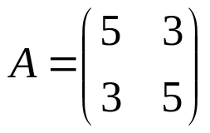
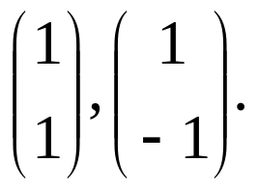
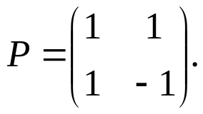
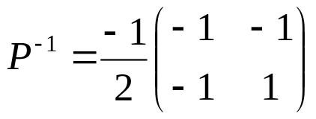
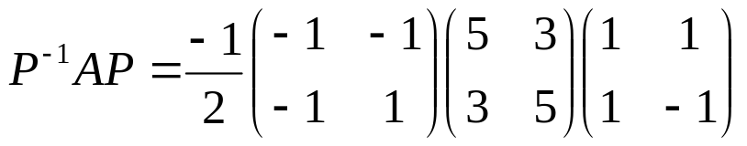
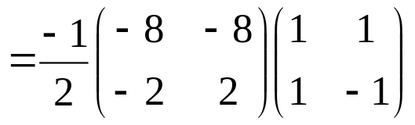
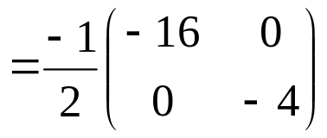
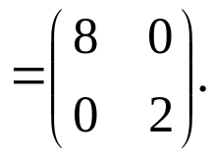
Diagonalize the matrix
Soln:
Step1. Eigen values of A are 2, 8 and the basis of eigen vectors are Therefore A is diagonalizable.
Step 2. Form the matrix So,
Step 3. Now,

Slide 10



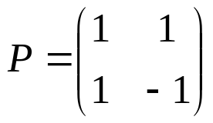
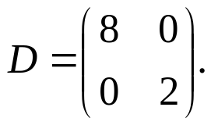
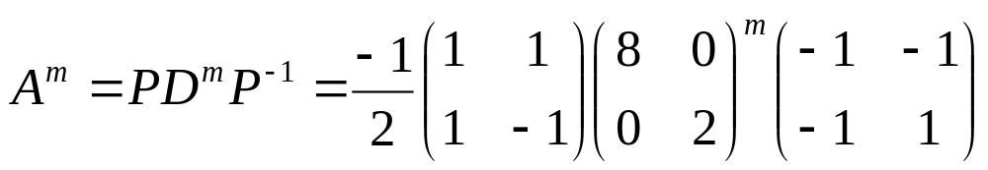
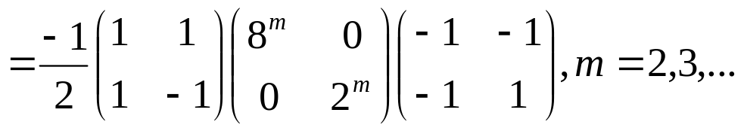
Computation of using Diagonalization of a Matrix
If an matrix A has a basis of eigenvectors, then
is diagonal, with the eigen values of A as the entries on the main diagonal. Here P is the matrix with these eigenvectors as column vectors. Also,
Example: Let . For , , we have
Thus

Slide 11
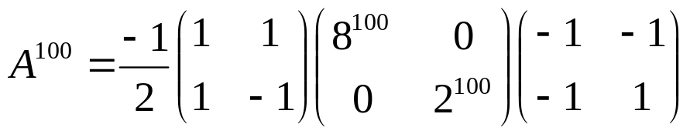
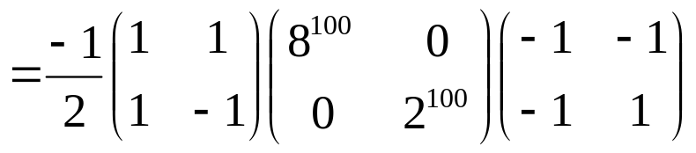
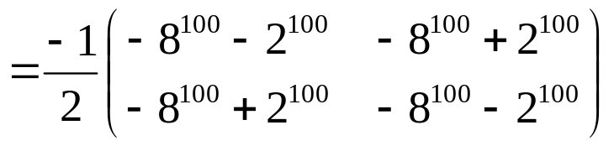
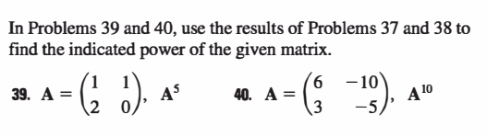
When m=100

Slide 12
Thank You

